Slide 1
Assignment 1.2
Shaquiel Pashtunyar
DSC640
Bar, Stacked Bar, Pie and Donut Charts

Slide 2
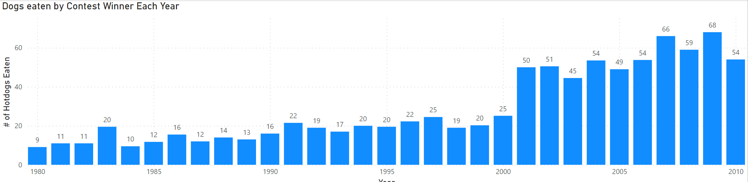
PBI Bar Chart

Slide 3
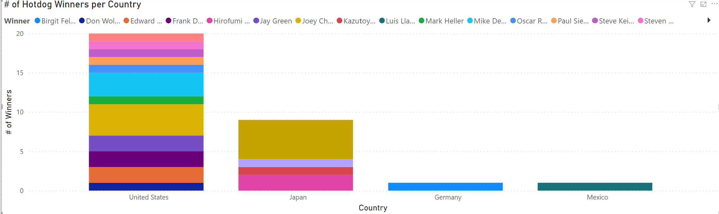
PBI Stacked Bar

Slide 4
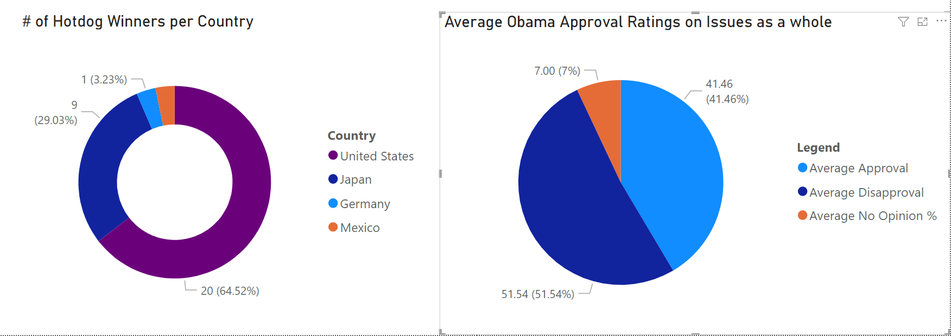
PBI Donut and Pie Chart

Slide 5
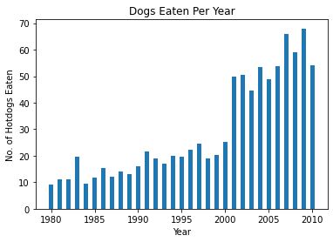
Python Bar
plt.bar(Hotdog["Year"], Hotdog["Dogs eaten"], width = .5)
plt.xlabel("Year")
plt.ylabel("No. of Hotdogs Eaten")
plt.title("Dogs Eaten Per Year")
plt.show()

Slide 6
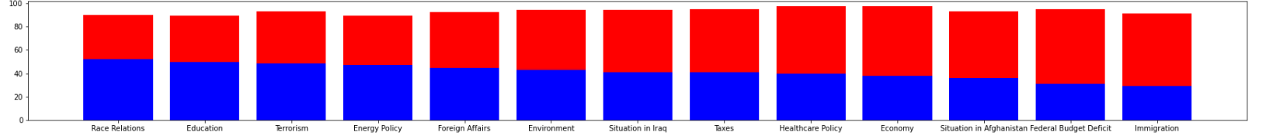
Python Stacked Bar
plt.bar(Obama["Issue"], Obama["Approve"], color='b')
plt.bar(Obama["Issue"], Obama["Disapprove"], bottom=Obama["Approve"], color='r')
plt.rcParams["figure.figsize"] = (30,3)
plt.show()

Slide 7
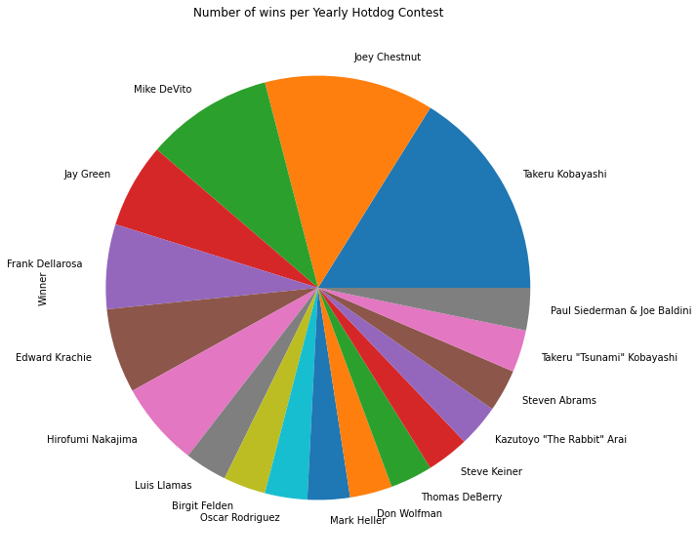
Python Pie Chart
HotdogWinner = Hotdog["Winner"].value_counts()
plt.figure(figsize=(20,10))
ax = HotdogWinner.plot(kind='pie')
ax.set_title("Number of wins per Yearly Hotdog Contest")

Slide 8
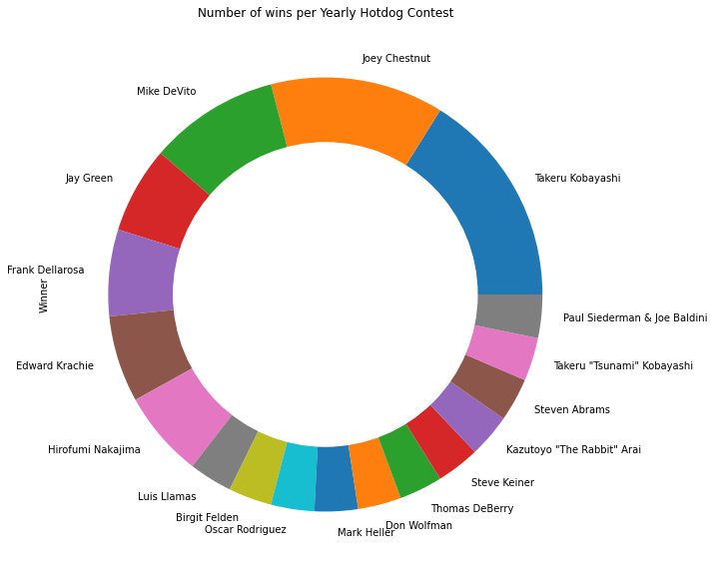
Python Donut Chart
plt.figure(figsize=(20,10))
ax = HotdogWinner.plot(kind='pie')
ax.set_title("Number of wins per Yearly Hotdog Contest")
circle = plt.Circle( (0,0), 0.7, color='white')
p=plt.gcf()
p.gca().add_artist(circle)

Slide 9
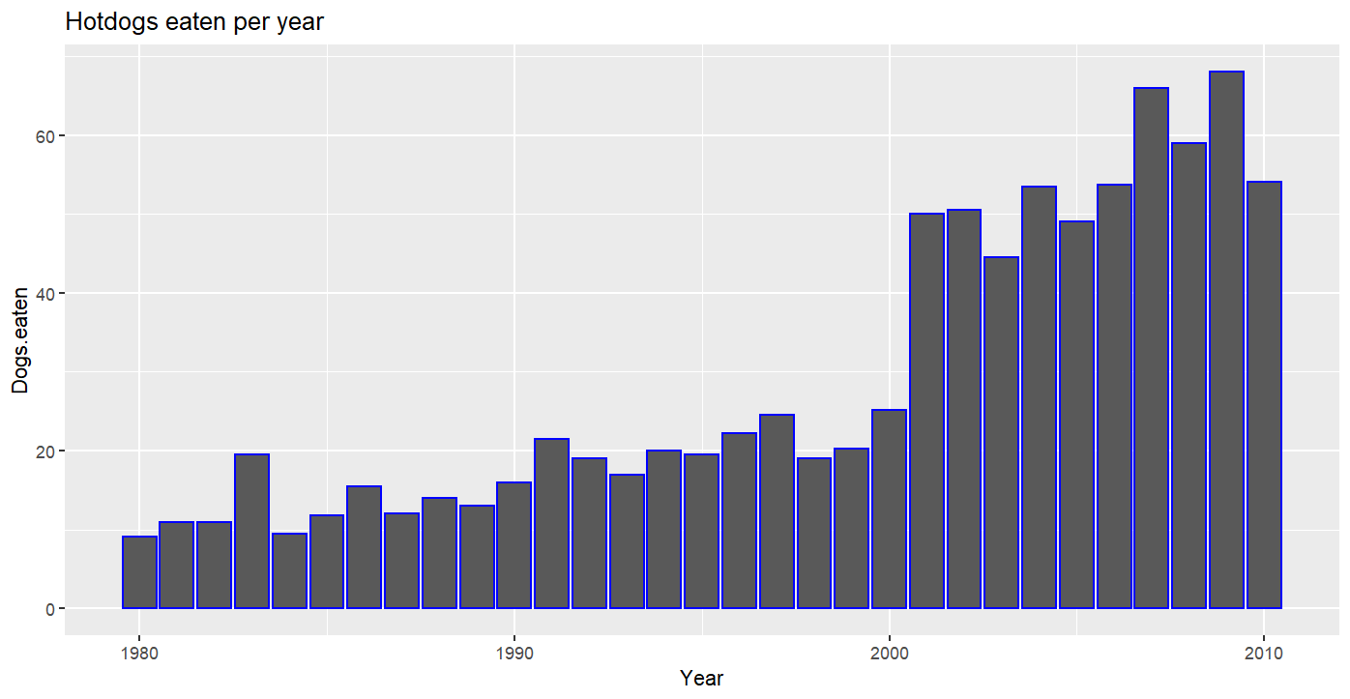
R Bar Chart
ggplot(Hotdog_df, aes(x=Year, y=Dogs.eaten)) + geom_bar(stat="identity", color="blue")+ggtitle("Hotdogs eaten per year")

Slide 10
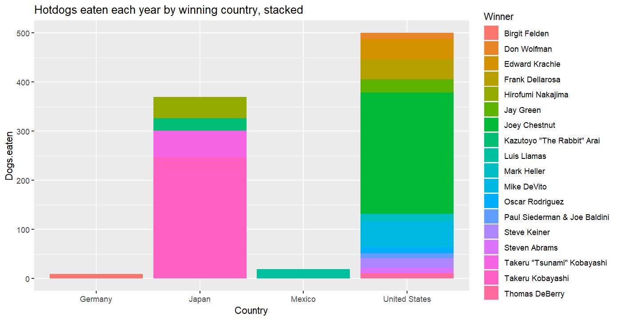
R Stacker Bar
ggplot(Hotdog_df, aes(fill=Winner, x=Country, y=Dogs.eaten)) + geom_bar(position="stack", stat="identity")+ggtitle("Hotdogs eaten each year by winning country, stacked")

Slide 11
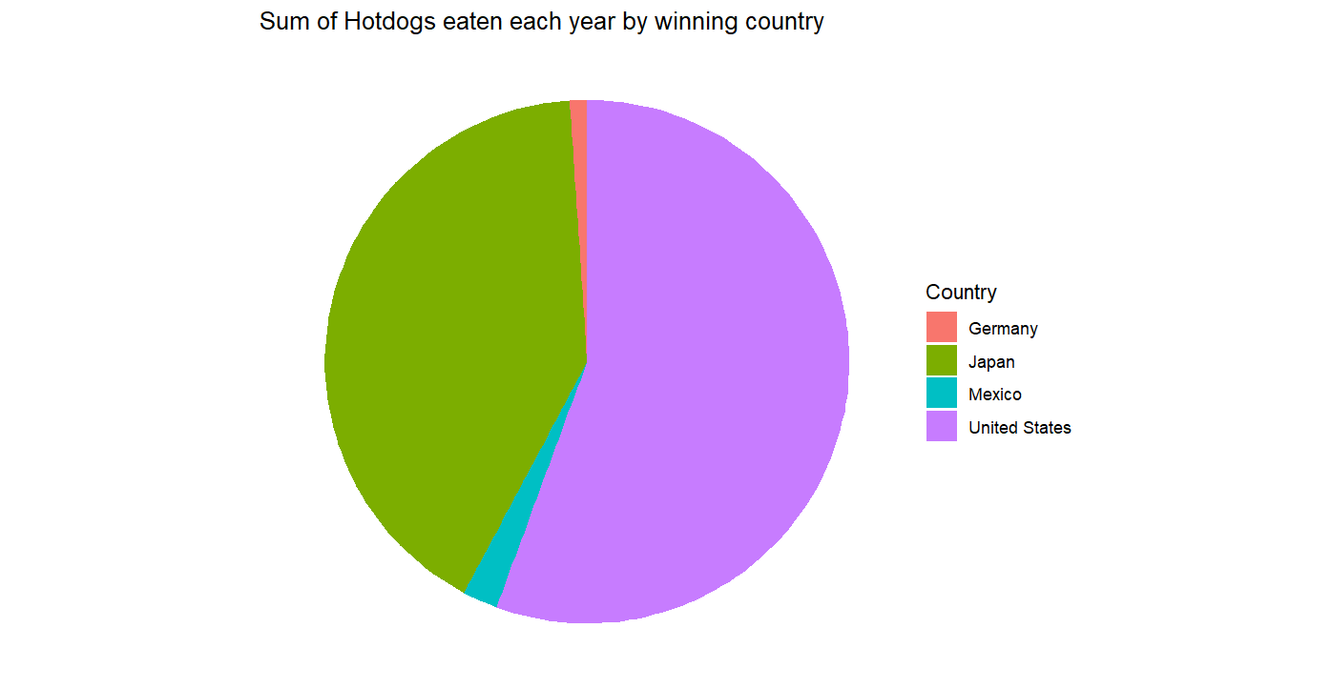
R Pie Chart
ggplot(Hotdog_df, aes(x="", y=Dogs.eaten, fill=Country)) +geom_bar(stat="identity", width=1) +coord_polar("y", start=0) + theme_void()+ggtitle("Sum of Hotdogs eaten each year by winning country")

Slide 12
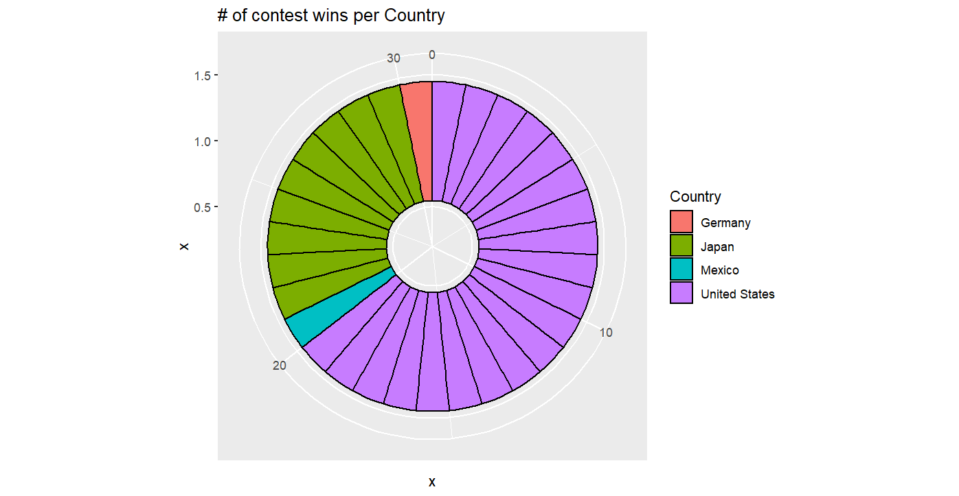
Donut Chart
hsize <- 1
Hotdog_df <- Hotdog_df %>% mutate(x = hsize)
ggplot(Hotdog_df, aes(x = x, y = x, fill = Country)) +
geom_col(color = "black") +
coord_polar(theta = "y") +
xlim(c(0.2, hsize + 0.5))+ggtitle("# of contest wins per Country")

